Slide 1


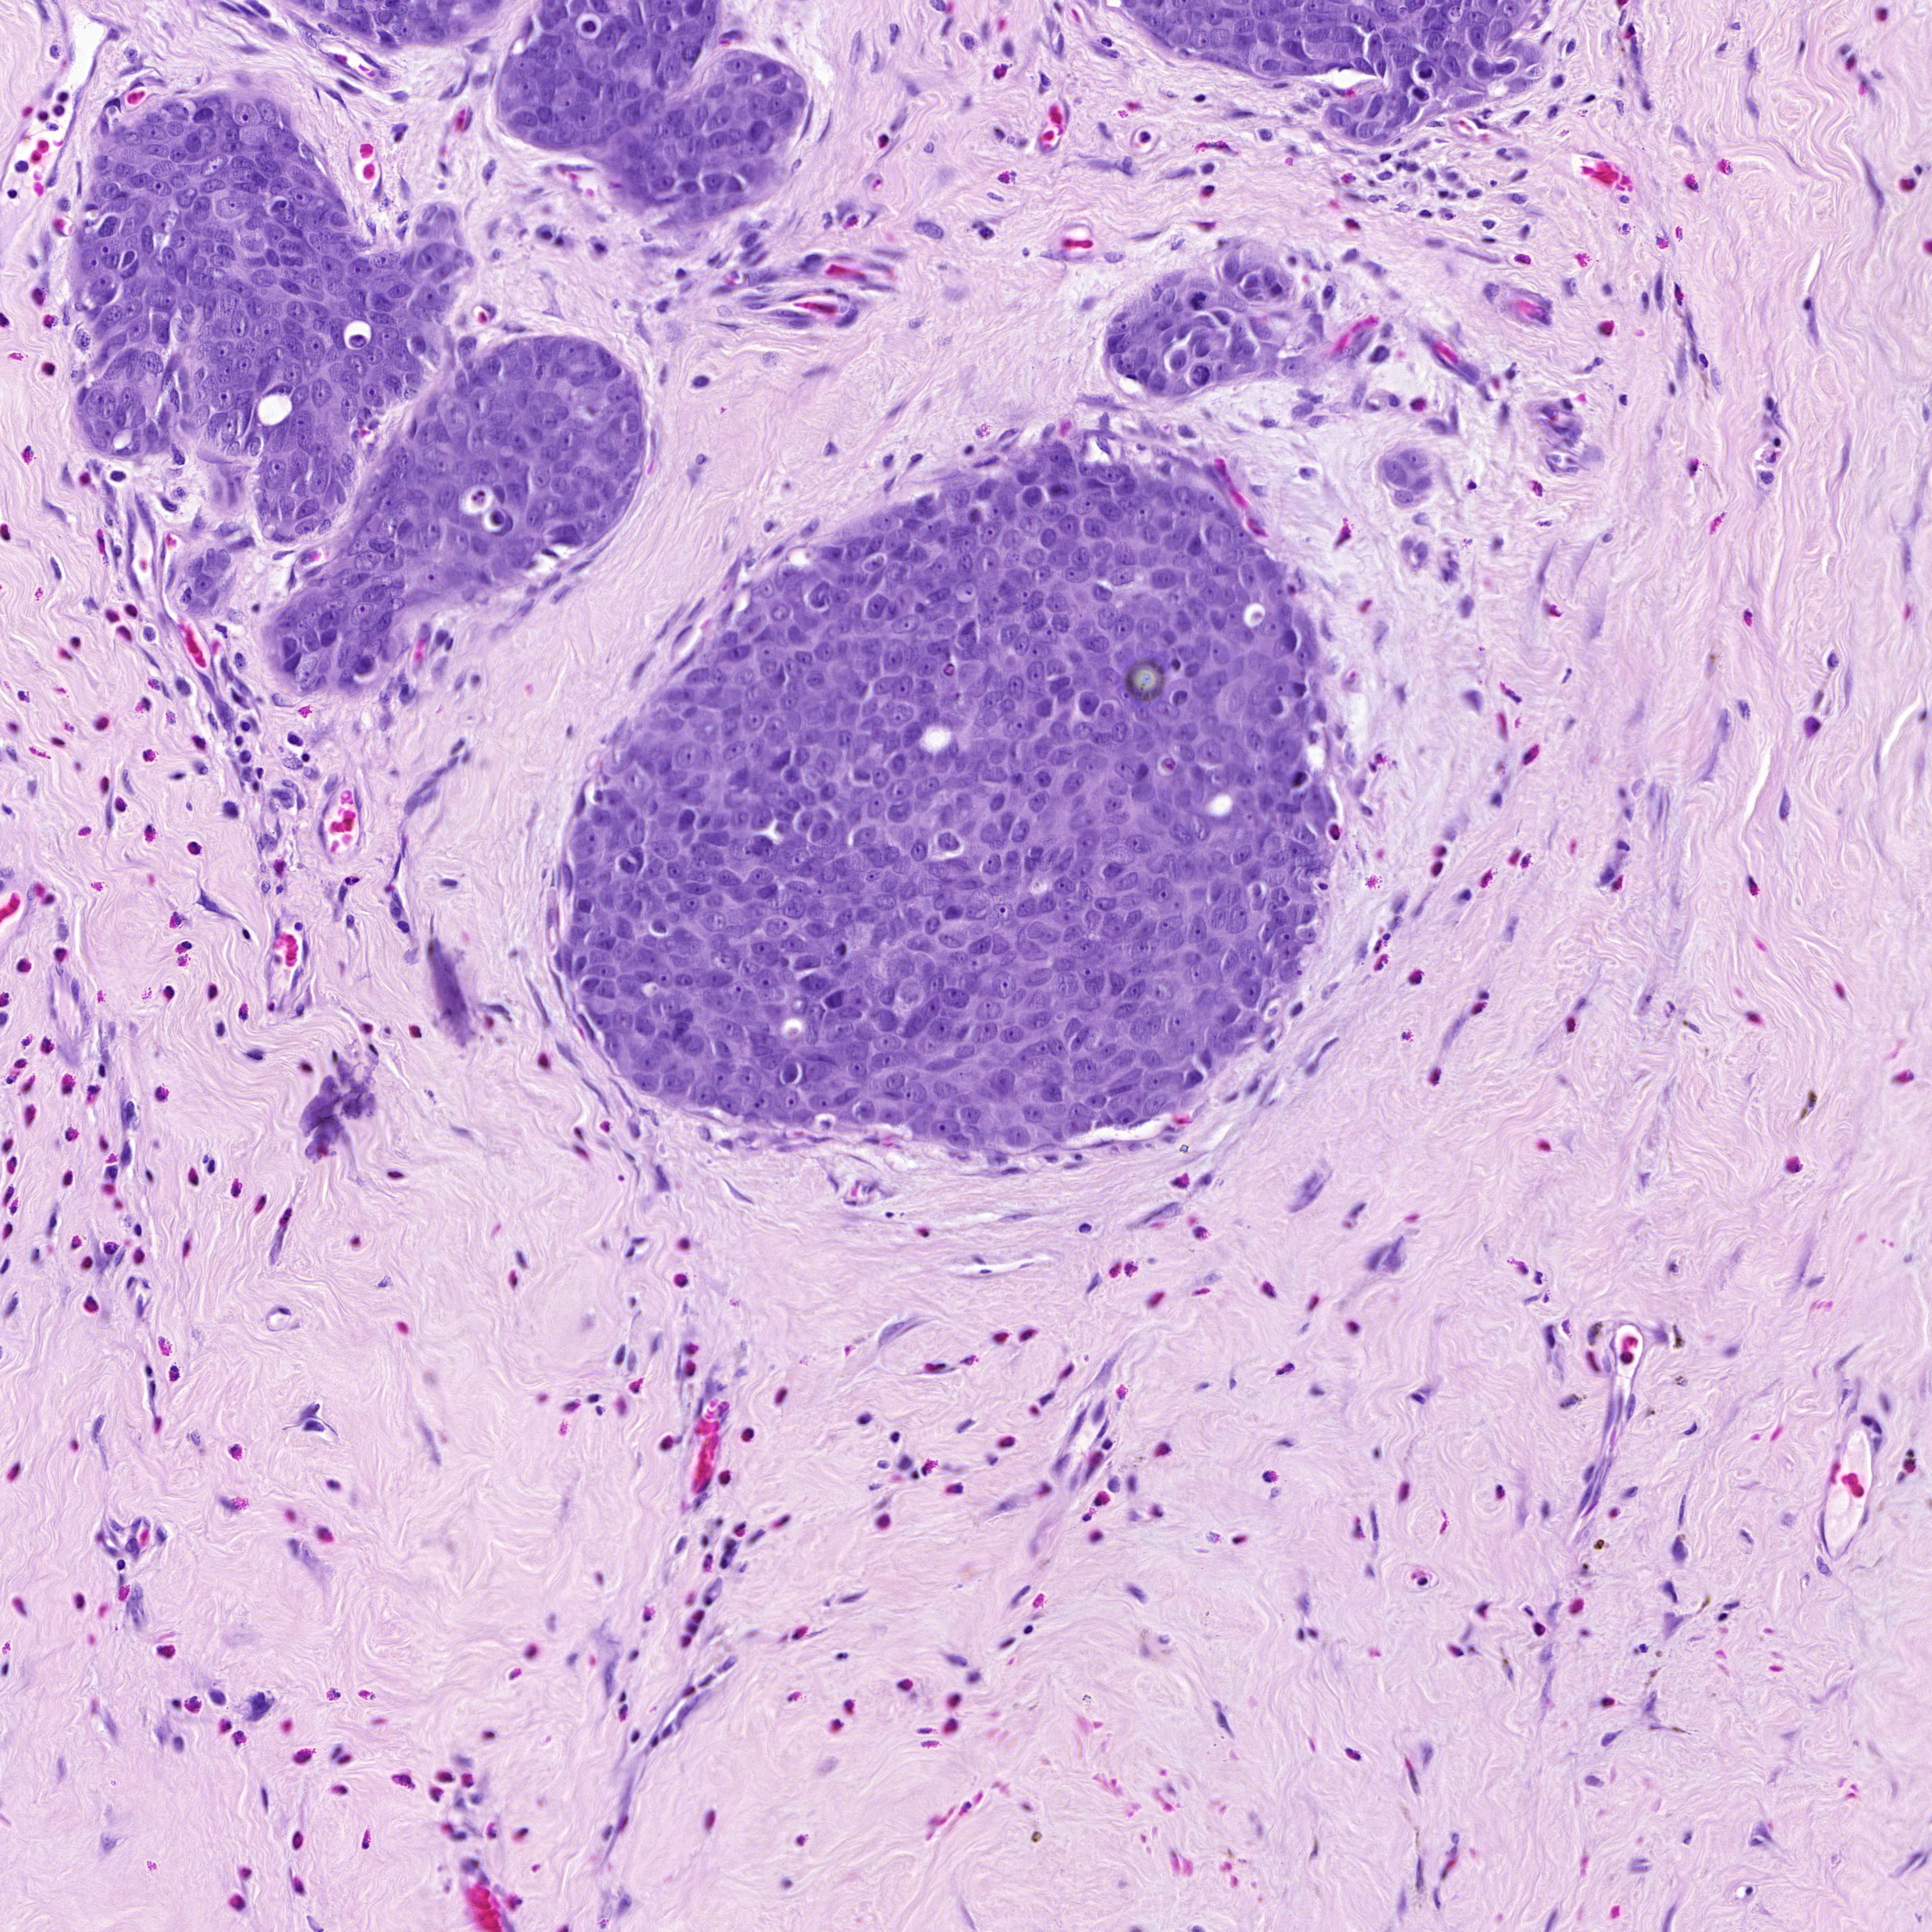
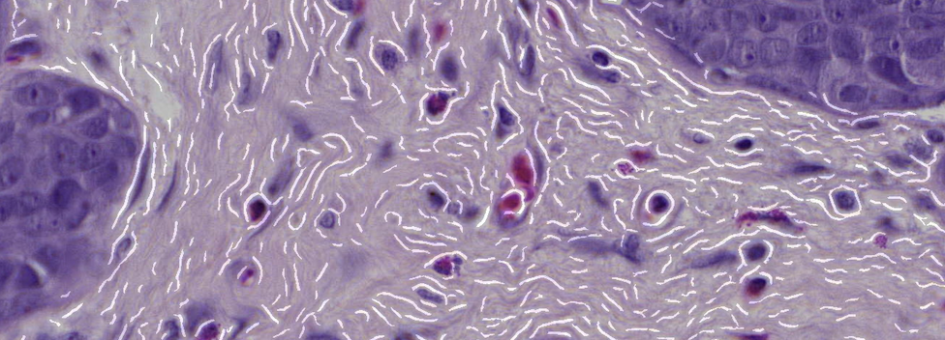
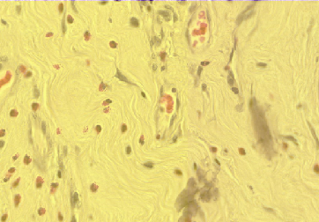

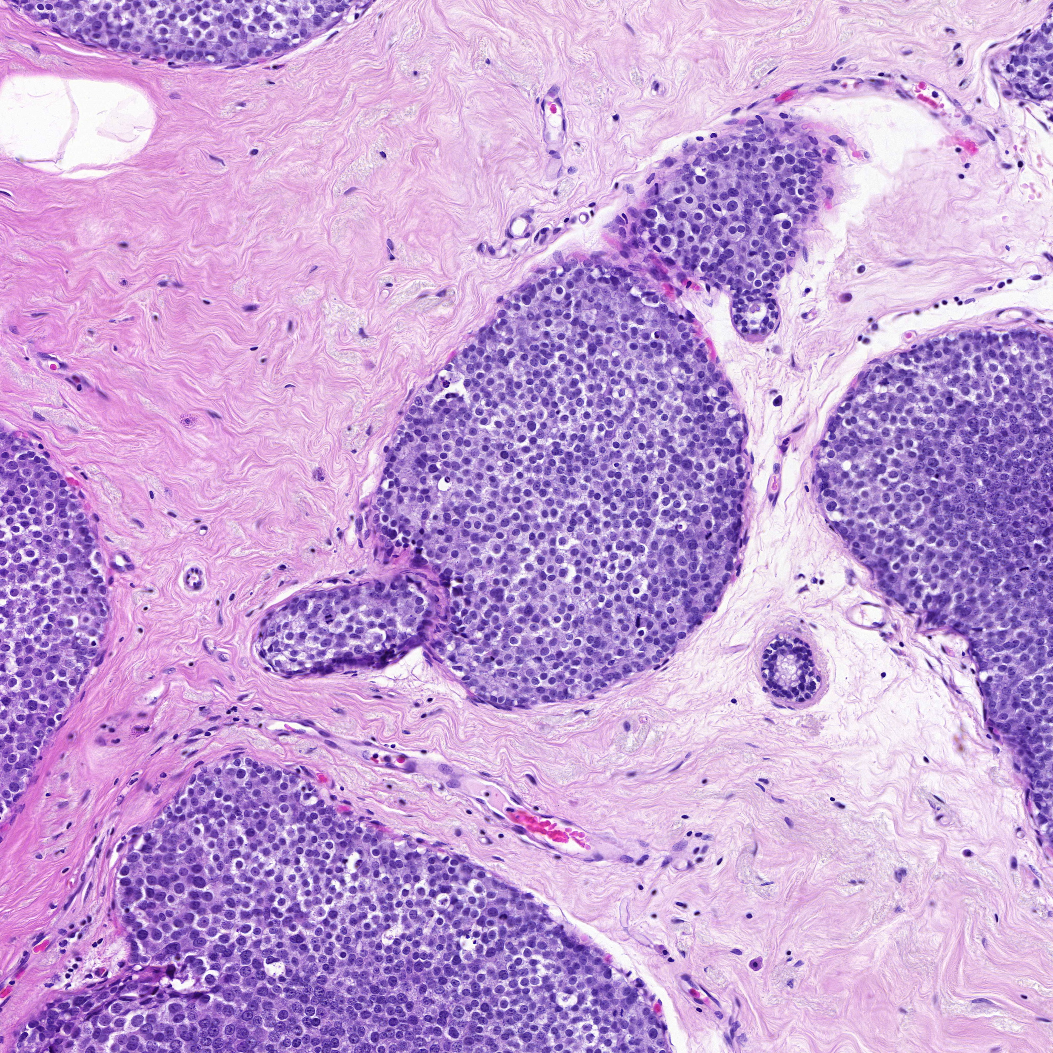
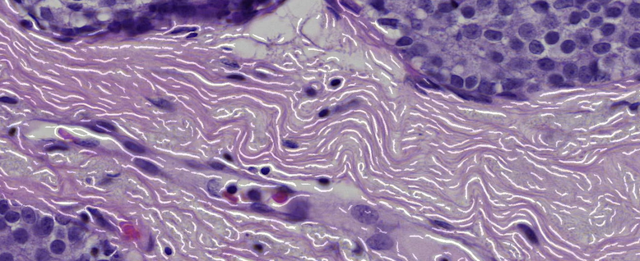
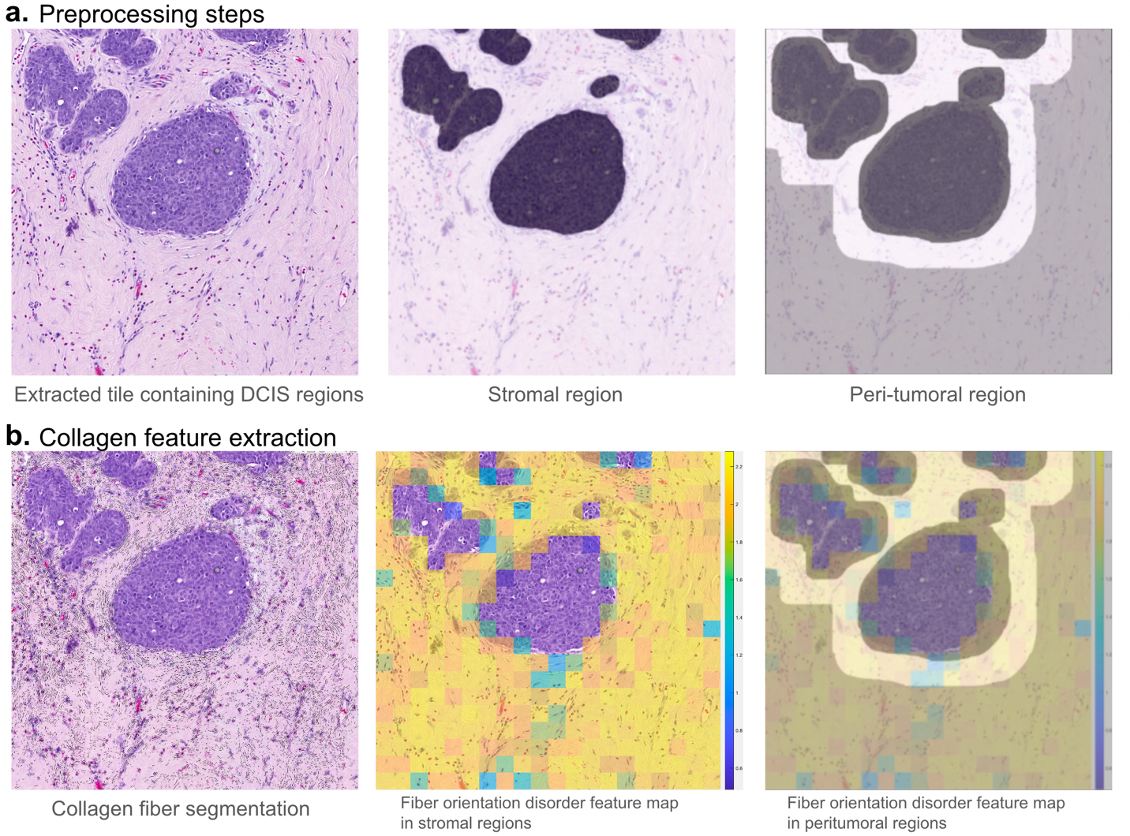
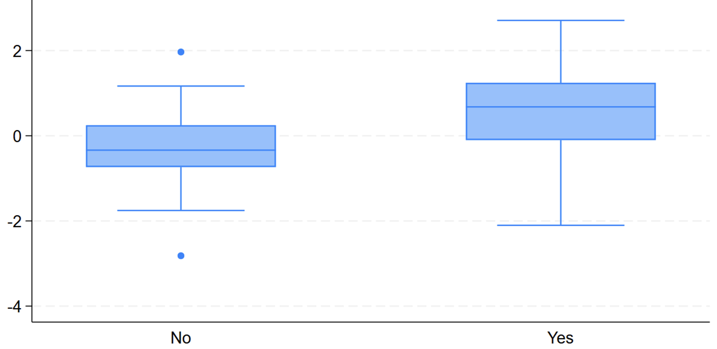
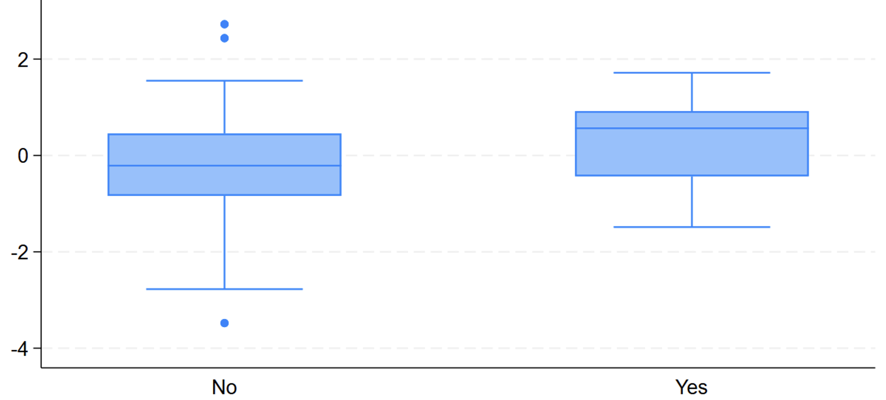







171P: A Computational Pathology Collagen Signature Predictive of Tamoxifen Benefit in Ductal Carcinoma in Situ: Results from a Cohort within the UK/ANZ DCIS Randomized Trial
Arpit Aggarwal¹, Sunil Badve^{2,3}, Jack Cuzick⁴, Anant Madabhushi^{1,5}, Mangesh A. Thorat^{4,6,7,8}
m.thorat@qmul.ac.uk, aagga56@emory.edu
¹Wallace H. Coulter Department of Biomedical Engineering, Emory University and Georgia Tech, Atlanta, GA, USA; ²Department of Pathology and Laboratory Medicine, Emory University School of Medicine, Atlanta, GA, USA; ³Winship Cancer Institute, Atlanta, GA, USA; ⁴Centre for Cancer Screening, Prevention and Early Diagnosis, Wolfson Institute of Population Health, Queen Mary University of London, London, UK; ⁵Atlanta Veterans Administration Medical Center, Atlanta, GA, USA; ⁶School of Cancer and Pharmaceutical Sciences, Faculty of Life Sciences and Medicine, King’s College London, London, UK; ⁷Breast Surgery, Homerton University, London, UK; ⁸Breast Surgery, Guy’s Hospital, Great Maze Pond, London, UK
`
Background
Results
Disorder in collagen fiber architecture, characterized by changes in collagen organization, plays a critical role in tumor progression.
In this study, we developed a collagen-based computational pathology biomarker and evaluated its association with tamoxifen benefit in the UK/ANZ DCIS randomized trial.
a. Tamoxifen-low
High disorder in collagen fibers in both peritumoral and stromal regions
Methods
We included 242 H&E Images from the UK/ANZ DCIS randomized controlled trial with patients undergoing tamoxifen treatment.
102 images (events=35) formed the training set (TrS), while 140 images (events=20) formed the validation set (VaS).
Figure 1 illustrates the process of extracting 12 features relating to collagen arrangement from H&E images. A Cox regression model was trained using these extracted features. A 66th percentile threshold was used in TrS to stratify patients into low- or high-risk groups in TrS and VaS.
b. Tamoxifen-high
Less disorder in collagen fibers in both peritumoral and stromal regions
Fig. 2: Collagen signature predicting tamoxifen benefit in DCIS patients (TrS: p<0.001, HR=4.54 [2.27-9.06], VaS: p=0.006, HR=3.46 [1.41-8.48]). Yellow indicates regions of high disorder, whereas blue signifies regions of less disorder in collagen fibers.
Fig. 3: Collagen signature differences in patients with and without DCIS recurrence in TrS and VaS cohort.
TrS
VaS
Conclusions
The disordered collagen architecture is associated with tamoxifen resistance in DCIS.
Our computational pathology collagen-tamoxifen score has a role, independent of ER-status, in predicting tamoxifen benefit in DCIS.
Acknowledgements
This work was funded by Cancer Research UK grants: C569/A12061 (to JC and MAT) and C569/A16891 (to JC and MAT). The Breast Cancer Research Foundation, New York (NY, USA), provided support for biospecimen collection and management activities. Research reported in this publication was supported by the National Cancer Institute under award numbers R01CA268287A1, U01CA269181, R01CA26820701A1, R01CA249992-01A1, R01CA202752-01A1, R01CA208236-01A1, R01CA216579-01A1, R01CA220581-01A1, R01CA257612-01A1, 1U01CA239055-01, 1U01CA248226-01, 1U54CA254566-01, National Heart, Lung, and Blood Institute 1R01HL15127701A1, R01HL15807101A1, National Institute of Biomedical Imaging and Bioengineering 1R43EB028736-01, VA Merit Review Award IBX004121A from the United States Department of Veterans Affairs Biomedical Laboratory Research and Development Service, the Office of the Assistant Secretary of Defense for Health Affairs, through the Breast Cancer Research Program (W81XWH-19-1-0668), the Prostate Cancer Research Program (W81XWH-20-1-0851), the Lung Cancer Research Program (W81XWH-18-1-0440 and W81XWH-20-1-0595).
Fig. 1: Overall Workflow. a Preprocessing steps. b Collagen feature extraction (Yellow indicates regions of high disorder, whereas blue signifies regions of less disorder in collagen fibers).

